Slide 1
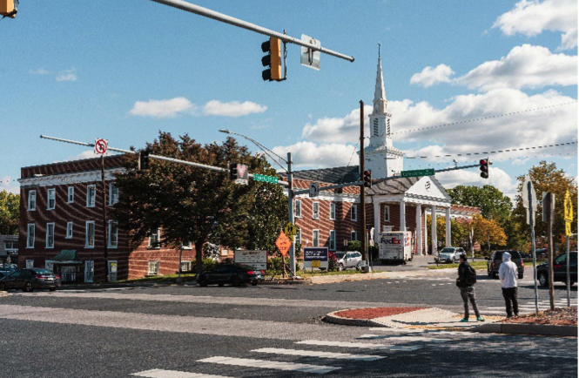
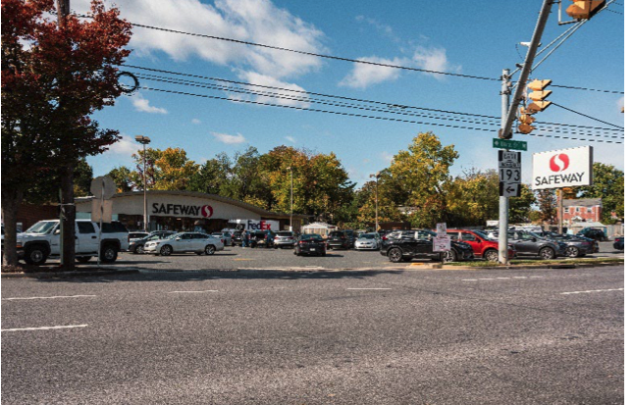
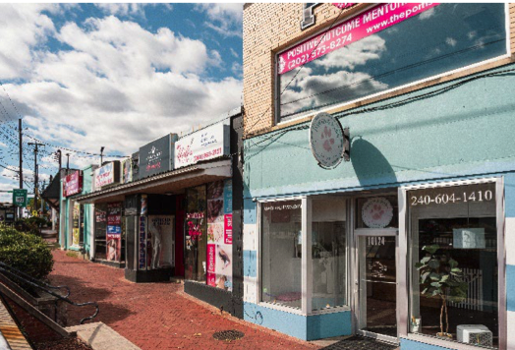
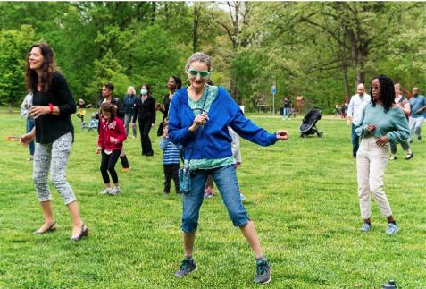
University Boulevard Corridor Plan

Slide 2
UNIVERSITY BOULEVARD CORRIDOR PLAN (UBCP)
PLAN VISION
Pedestrian-oriented
Multimodal
Safe, accessible, and healthy travel options
Vibrant, connected communities
Diverse range of housing options
Supported by Bus Rapid Transit (BRT)

Slide 3
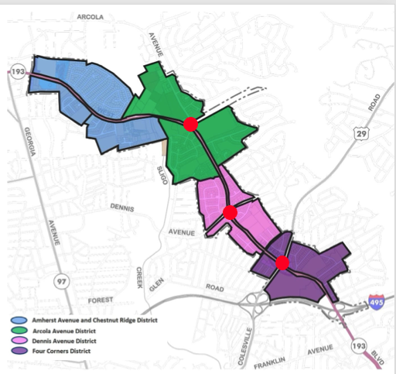
PLAN FRAMEWORK
FOUR DISTRICTS in UBCP
3 Future BRT Stops
NFCCA focus:
Arcola Ave District
Dennis Ave District
Four Corners “Town Center”
District

Slide 4
Urban Design Strategy
Environmental Sustainability
Promote transit-supportive development near BRT
Expand housing choice on properties abutting University Blvd. between planned BRT stops
Identify multimodal improvements
Recommend developing University Blvd. as “Cool Corridor”
Tree canopy, shaded transit shelters
Runoff reduction, landscaping
Design for trees, reduce utility line conflicts
Increase tree canopy and landscaping
Promote energy conservation options for redevelopment

Slide 5
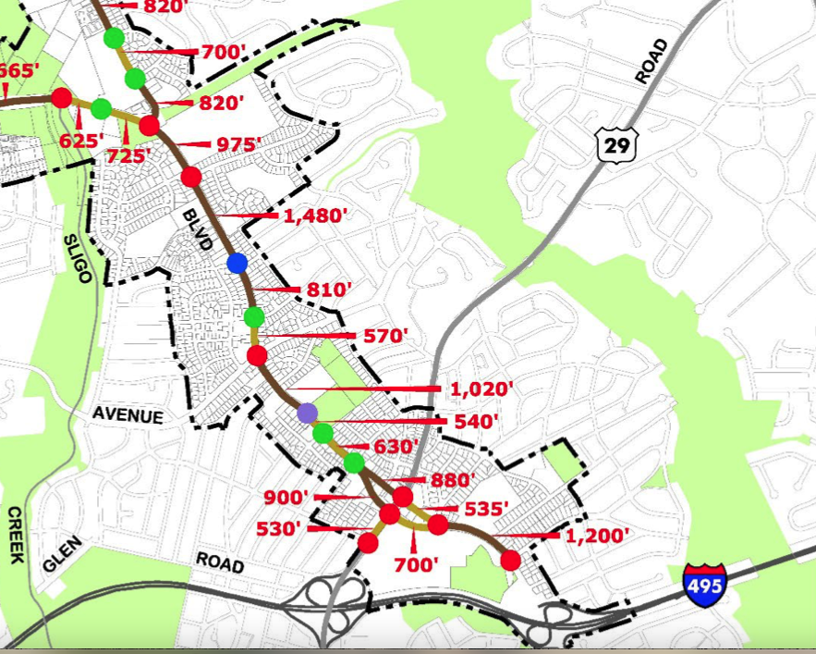
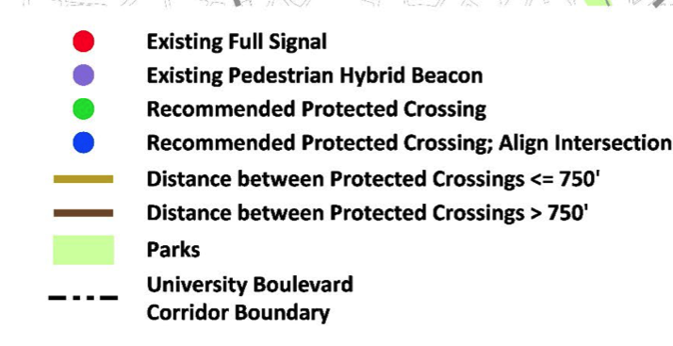
Transportation
Complete network of comfortable sidewalks and bikeways connected by safe protected crossings
Support opportunities for micro-mobility, bike share and electric charging stations

Slide 6
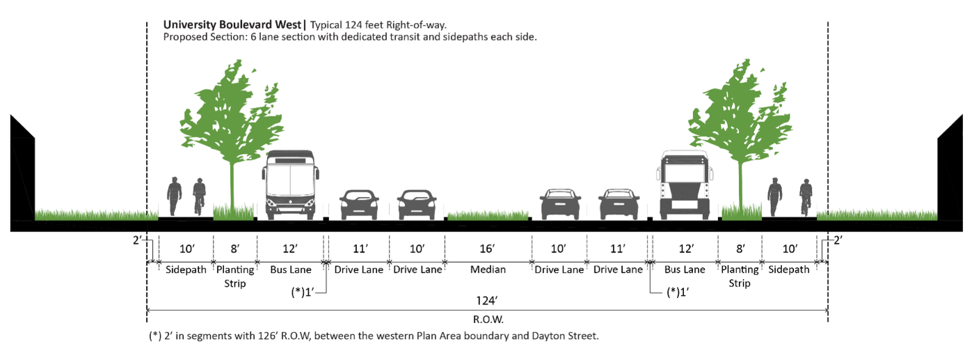
Transportation -- University Boulevard
10’ buffered sidepaths on both sides of University Blvd.
With redevelopment or BRT implementation consolidate, remove, or relocate driveways on University Blvd.
Dedicated transit lanes along University Boulevard, except for area between Lorain Ave. and Williamsburg Drive

Slide 7
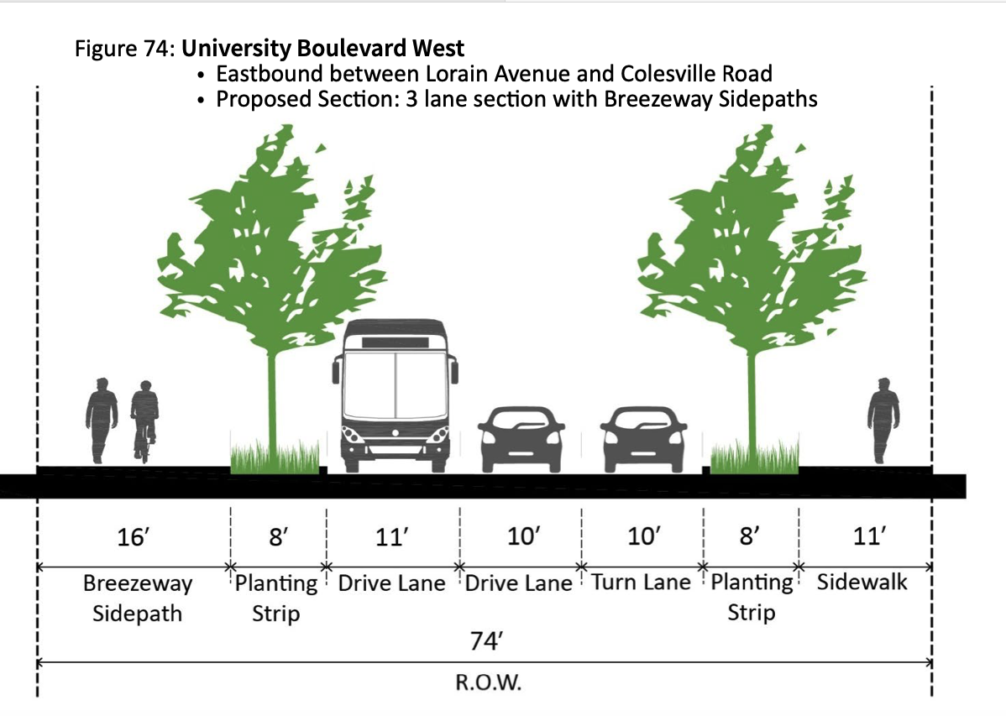
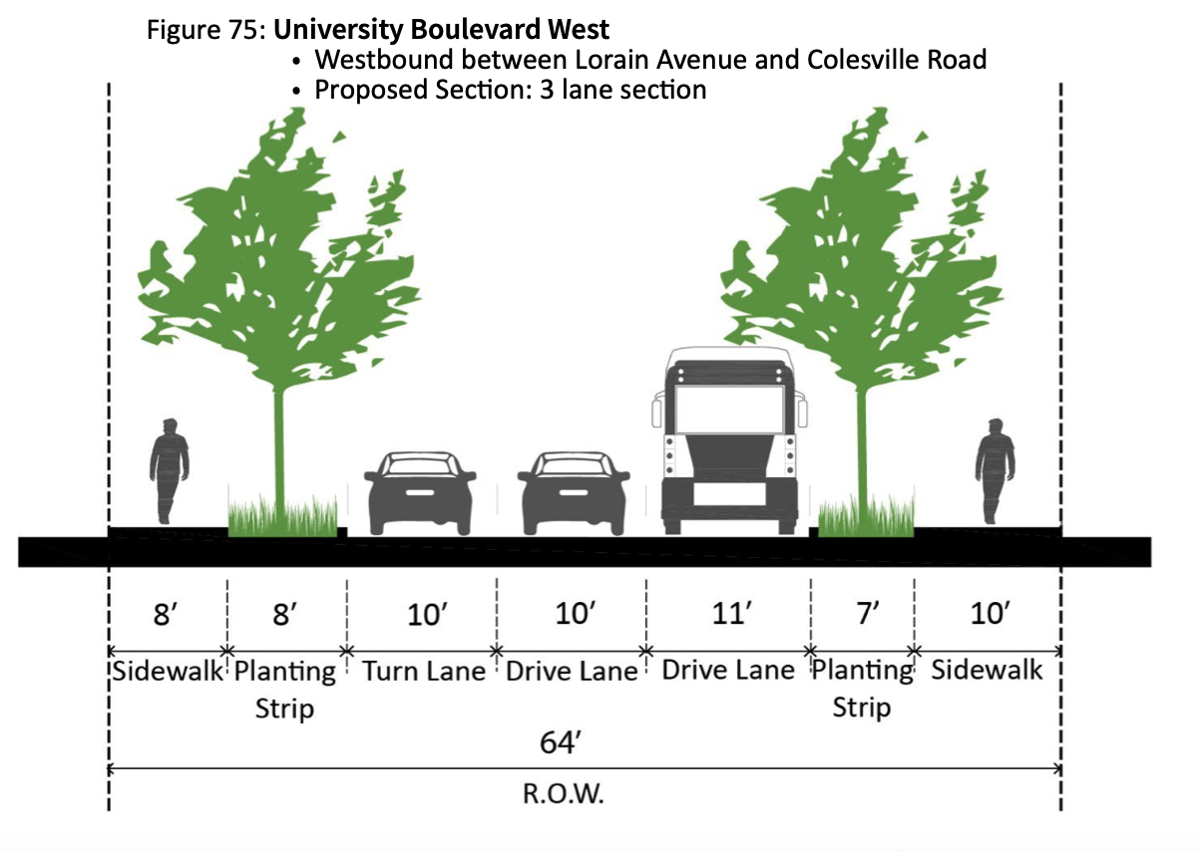
Transportation – Four Corners
Lorain to Colesville Rd. – East & West

Slide 8
Transportation – Four Corners
Repurpose one lane in each direction for pedestrian buffer and wider sidewalk or sidepath
In near-term maintain existing median couplet
Study options for improving transit performance, multimodal safety, human scale, and street buffers over traffic capacity and travel speed
Consider options to improve public transit at Four Corners, including signal priority or relocating bus stops

Slide 9
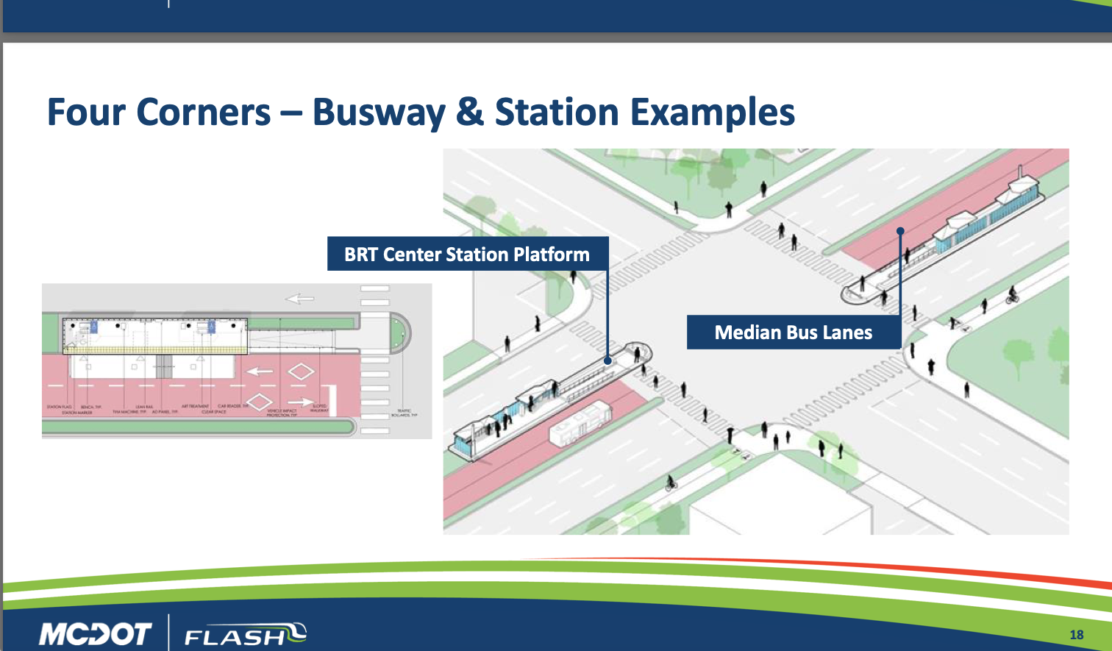
Transportation Four Corners—BRT Station
UBCP proposes relocating Route 29/Colesville Rd. Bus Rapid Transit stations to mid-intersection at Four Corners

Slide 10
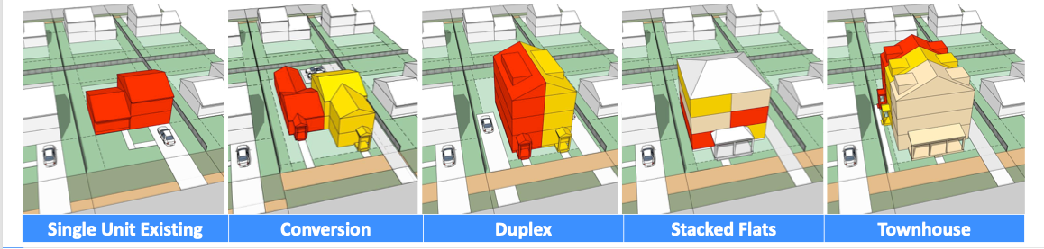
Rezoning to Allow Different Housing Types
Permissible land uses, development standards, and development procedures will support increased housing diversity near transit and establish transitions to existing neighborhoods

Slide 11
Limits on Size & Use—Floor Area Ratio (FAR)
Residential
Floor Area Ratio (FAR) limits the:
Maximum square footage of a building compared to lot size
Mix of uses – residential or commercial/retail
Residential
Commercial
Example: Commercial Residential Town (CRT) zone
10,000 square foot lot
Maximum FAR of 2.25, C-1.5, R-2.0, Height 60
Maximum building size is 22,500 square feet
Developer decides ratio of commercial vs residential
15000 sq.ft. commercial & 7500 sq.ft. residential
2250 sq.ft. commercial & 20000 sq.ft. residential
5000 sq.ft. commercial & 17500 sq.ft. residential

Slide 12
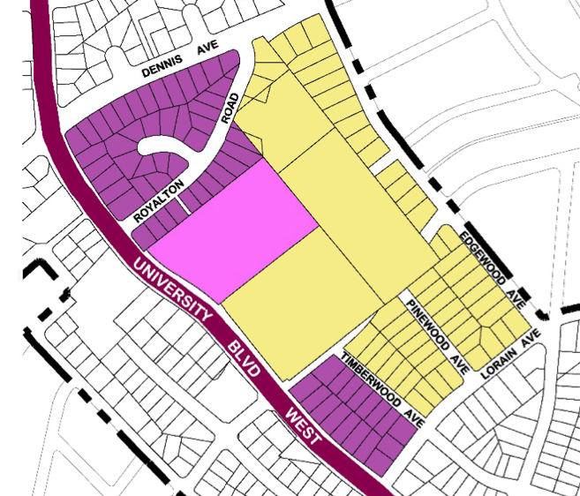
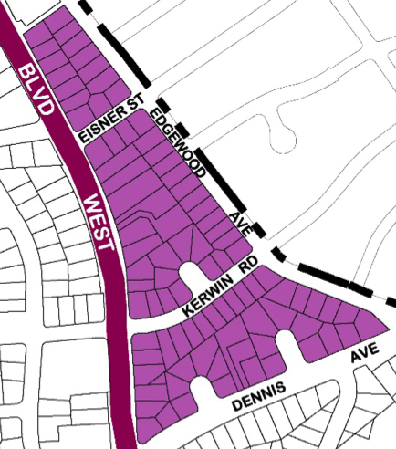
Commercial Residential Neighborhood Zoning (CRN)
Rezoning Changes in the NFCCA Community
The original draft of the UBCP, as proposed by the Montgomery County Planning Commission, recommended rezoning from single family residential to Commercial Residential Neighborhood (CRN) for over 200 homes in the NFCCA community!

Slide 13
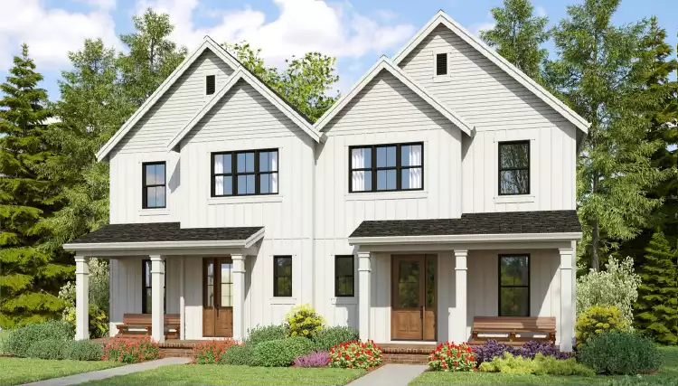
Commercial Residential Neighborhood (CRN)
What does CRN zoning allow?
Duplex, triplex, quadplex
Small multifamily up to 19 units
Can purchase multiple adjoining lots to redevelop as larger multi-unit structures (no limit on number of properties consolidated, but all must abut the corridor)
Duplex housing type standards apply to lots under 15,000 square feet
For lots greater than 15,000 square feet, the development standard for applicable building type will be used

Slide 14
Commercial Residential Neighborhood (CRN)
Where does CRN rezoning apply in the NFCCA community?
Homes that abut the University Blvd. corridor (that is, lots with frontage on University Blvd.)
Includes “flag” lots connected to corridor via access driveways
Homes on 2nd block of Colesville Road (10200 – 10226)

Slide 15
Commercial Residential Neighborhood (CRN)
Rezoning Changes in the NFCCA Community
What restrictions are there on building size and uses in a CRN zone?
Maximum Building FAR is 1.0 times lot size
Residential only, no commercial uses (allows existing exceptions for home businesses, etc.)
Height 45’

Slide 16
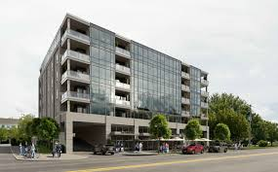
Commercial Residential Town (CRT)
Mixed Use—Commercial and Residential
What is Commercial Residential Town (CRT) zoning?
CRT zoning allows mixed use Commercial and Residential redevelopment
Percentages applied by the applicable FAR give the redeveloper some flexibility to adjust the mix of Commercial and Residential uses

Slide 17
Commercial Residential Town (CRT)
Mixed Use—Commercial and Residential
How will CRT zones affect the NFCCA area?
In the NFCCA area, the UBCP applies CRT zoning to:
Religious institution properties
Existing affordable housing properties
Commercial properties near existing and future Bus Rapid Transit stations at Four Corners and Dennis Ave.

Slide 18
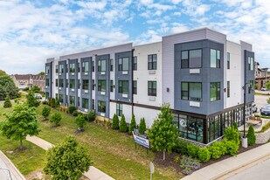
Commercial Residential Town (CRT)
Mixed Use—Commercial and Residential
Luther Rice Memorial Baptist Church
Maximum Building FAR is 1.5 times lot size
Commercial FAR is .25
Residential FAR is 1.5
Height 60’
Example:
Builder could choose to devote 0.25 of the allowable square footage as a commercial use, but this would limit residential to 1.25 of overall space.
Or the developer could choose to develop solely as residential

Slide 19
Commercial Residential Town (CRT)
Mixed Use—Commercial and Residential
The Oaks—Housing Opportunities Commission site
Maximum Building FAR 1.5
Commercial FAR 0.25
Residential FAR 1.5
Height 65’ or 70’

Slide 20
Future Dennis Avenue Bus Rapid Transit Station
Future Bus Rapid Transit Station at Dennis Avenue intersection with University Blvd. (not yet in the planning or design phase)
Mix of CRN and CRT zoning
Homes abutting the corridor in the NFCCA community rezoned as CRN
Existing commercial uses rezoned as CRT

Slide 21
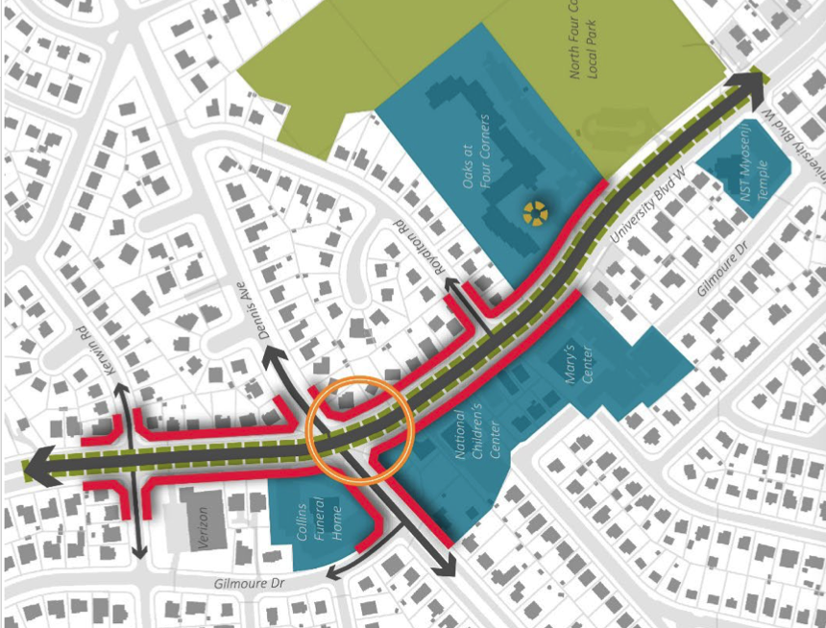
Future Dennis Avenue Bus Rapid Transit Station
Build to Line reduces applicable front setback
Rationale: creates visual effect inducing drivers to reduce speed
Includes CRN-zoned homes in the Dennis Avenue area
Commercial Residential Town (CRT) zoning applies to blue-shaded properties in the illustration
Red = Build to Line

Slide 22
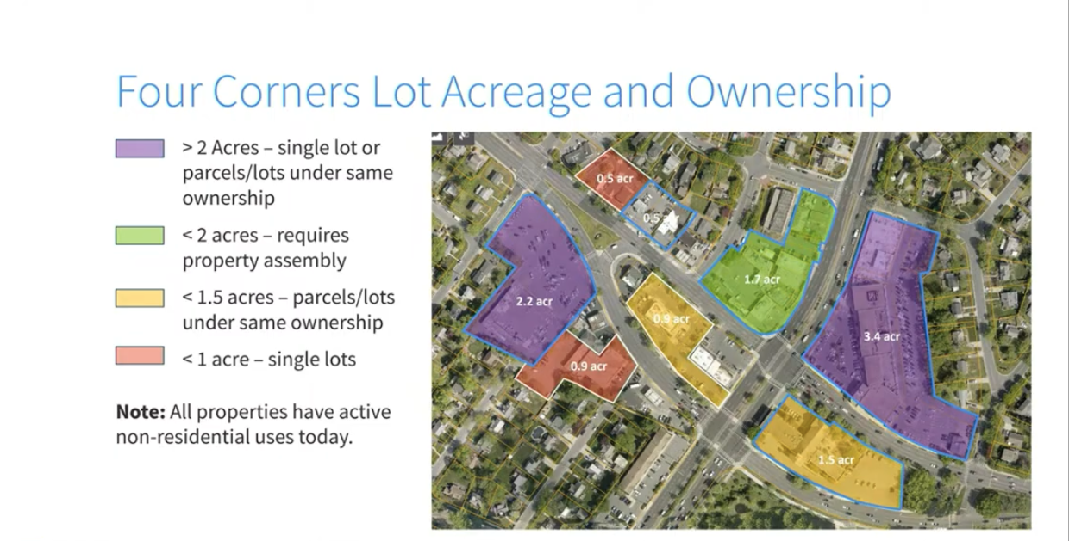
Four Corners “Town Center”
Common ownership of larger plots may encourage redevelopment

Slide 23
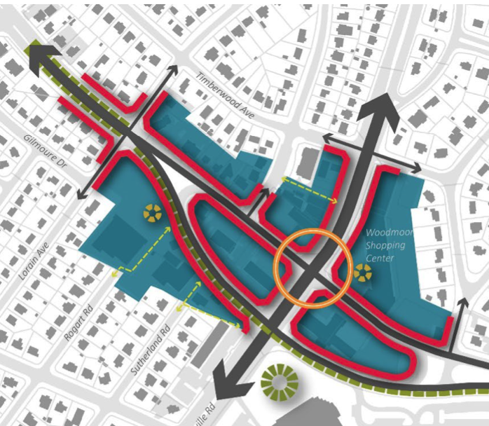
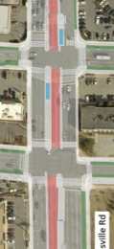
Four Corners “Town Center”
Red = Build to Line
FLASH Bus Stations in Median Lane at Intersection
BRT
STOP

Slide 24
Four Corners “Town Center”
Commercial Residential Town (CRT)
Mixed Use—Commercial and Residential
Higher building limits for:
Dunkin Donuts site
Commercial shopping strip facing Colesville Road
Safeway site
Properties located in median ”couplet” between University Blvd. East and West

Slide 25
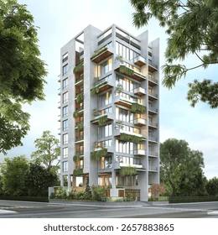
Four Corners “Town Center”
Commercial Residential Town (CRT)
Mixed Use—Commercial and Residential
Dunkin Donuts site
Council preserved existing zoning with 100’ height limit
Maximum Building FAR is 3.0
Commercial FAR is 1.5
Residential FAR is 2.0
Height 100’

Slide 26
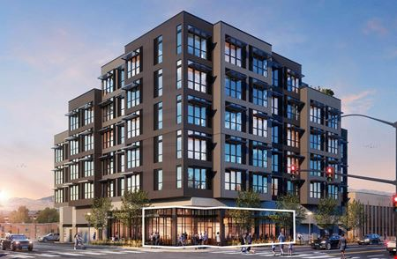
Four Corners “Town Center”
Commercial Residential Town (CRT)
Mixed Use—Commercial and Residential
Commercial properties
10100 to 10134 facing Colesville
Various restaurants and shops, including Red Maple and Corner Pub
Maximum Building FAR is 2.25
Commercial FAR is 1.5
Residential FAR is 1.5
Height 70’

Slide 27
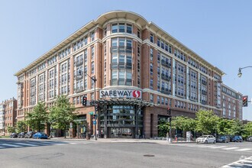
Four Corners “Town Center”
Commercial Residential Town (CRT)
Mixed Use—Commercial and Residential
Safeway
Maximum FAR 2.25
Commercial 1.5
Residential 1.5
Height 65’

Slide 28
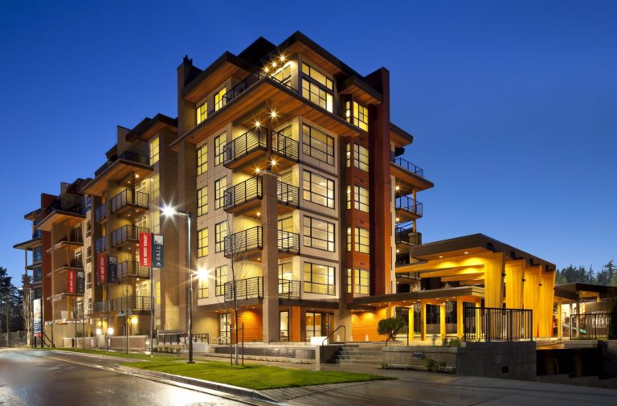
Four Corners “Town Center”
Commercial Residential Town (CRT)
Mixed Use—Commercial and Residential
Four Corners Ethiopian Evangelical Church
Maximum Building FAR 2.25
Commercial Far is 1.5
Residential FAR is 1.5
Height 65’

Slide 29
Four Corners “Town Center”
Commercial Residential Town (CRT)
Mixed Use—Commercial and Residential
Properties in median “couplet”
7-11
Vitamin Shoppe
McDonald’s
Papa John’s
Maximum Building FAR 2.25
Commercial Far is 1.5
Residential FAR is 1.5
Height 65’

Slide 30
Four Corners “Town Center”
Commercial Residential Town (CRT)
Mixed Use—Commercial and Residential
At property sites elsewhere in the Four Corners “Town Center” the County Council set building height at 60 feet for the remaining CRT-zoned commercial/multifamily properties
Below the recommended heights adopted by the Planning Board, which ranged as high as 75 to 100 feet

Slide 31
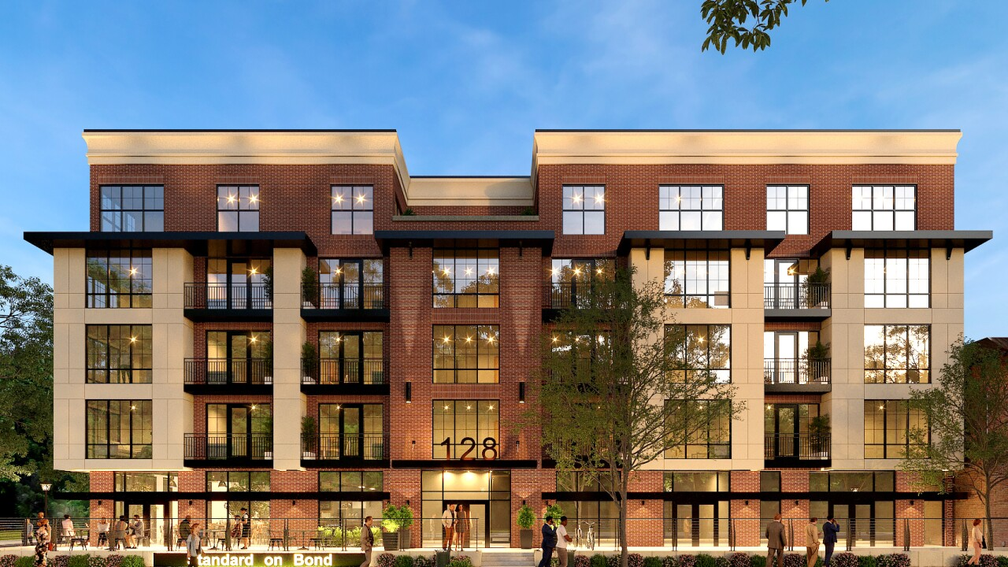
Four Corners “Town Center”
Commercial Residential Town (CRT)
Mixed Use—Commercial and Residential
Various commercial properties 105 – 111 University Blvd West
Maximum Building FAR is 2.25
Commercial FAR is 1.5
Residential FAR is 1.5
Height 60’

Slide 32
Four Corners “Town Center”
Commercial Residential Town (CRT)
Mixed Use—Commercial and Residential
Citgo Station – 101 University Blvd West
Maximum Building FAR is 2.25
Commercial FAR is 1.5
Residential FAR is 1.5
Height 60’

Slide 33
Four Corners “Town Center”
Commercial Residential Town (CRT)
Mixed Use—Commercial and Residential
Shell Station—10144 Colesville Road
Substation—110 Sutherland Road
Maximum Building FAR is 2.25
Commercial FAR is 1.5
Residential FAR is 1.5
Height 60’

Slide 34
Four Corners “Town Center”
Commercial Residential Town (CRT)
Mixed Use—Commercial and Residential
Woodmoor Shopping Center
Recommend evaluating for historic preservation listing
Maximum Building FAR is 2.0
Commercial Far is 1.5
Residential FAR is 1.5
Height 60’

Slide 35
Four Corners “Town Center”
Commercial Residential Town (CRT)
Mixed Use—Commercial and Residential
Sites 100, 110 and 112
University Boulevard West
U.S. Postal Service office
BP auto service
Shell gas station
Maximum Building FAR is 2.25
Commercial FAR is 1.5
Residential FAR is 1.5
Height 60’

Slide 36
UBCP: Housing Affordability
Concern that redevelopment of less affordable new housing would replace existing market rate housing
Council considered protections:
Give priority to existing residents for units under market-affordable rental agreements
Require set aside for income-restricted units with redevelopment of three or more units
Set process to track data on impact of redevelopment

